Slide 1
The Prediction of Traffic Collision Severity
Michel Soto
August 2020

Slide 2
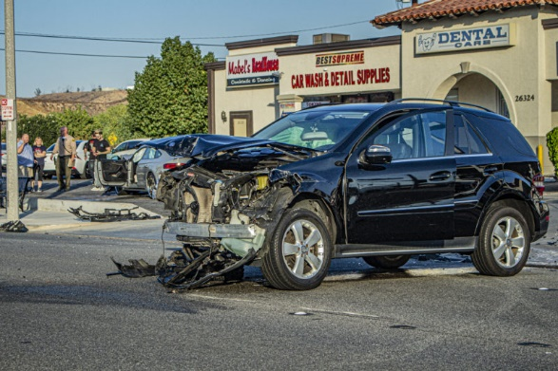
Problems with traffic collisions
Life or death situation
Repair or insurance bills
Hospital bills
Causes traffic
Others get delayed
Impossible to prevent all

Slide 3

Solution
Predict severity of collisions
Understand when there is higher risk of a sever collision.
Alert the population before it happens.
Driver sees the alert, and drives carefully

Slide 4
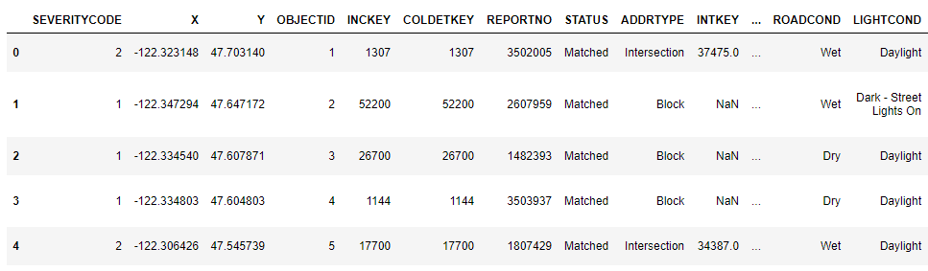
1. Get the Data

Slide 5
2. Recognize the column to predict.

Slide 6
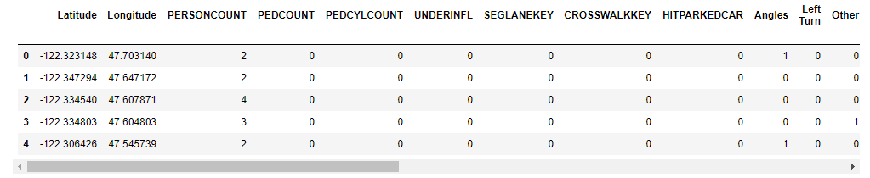
3. Prepare the data

Slide 7
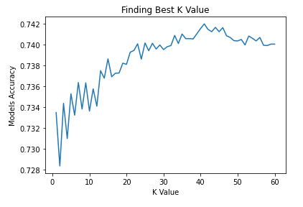

K-Nearest Neighbor
The best value for K is the highest accuracy.
The higher the accuracy of our model, the better it will predict collisions.
Best value for K is 50, and accuracy is 0.741989.
KNN will predict severity of collisions correctly 74.20% of the time.

Slide 8

Decision Tree
Accuracy for our model is 0.6933
Decision Tree will predict severity of collisions correctly 69.33% of the time.

Slide 9
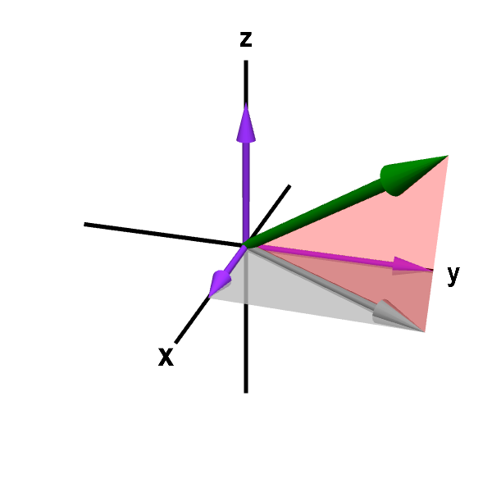
Support Vector Machine
Accuracy for our model is 0.7444
SVM will predict severity of collisions correctly 74.44% of the time.

Slide 10
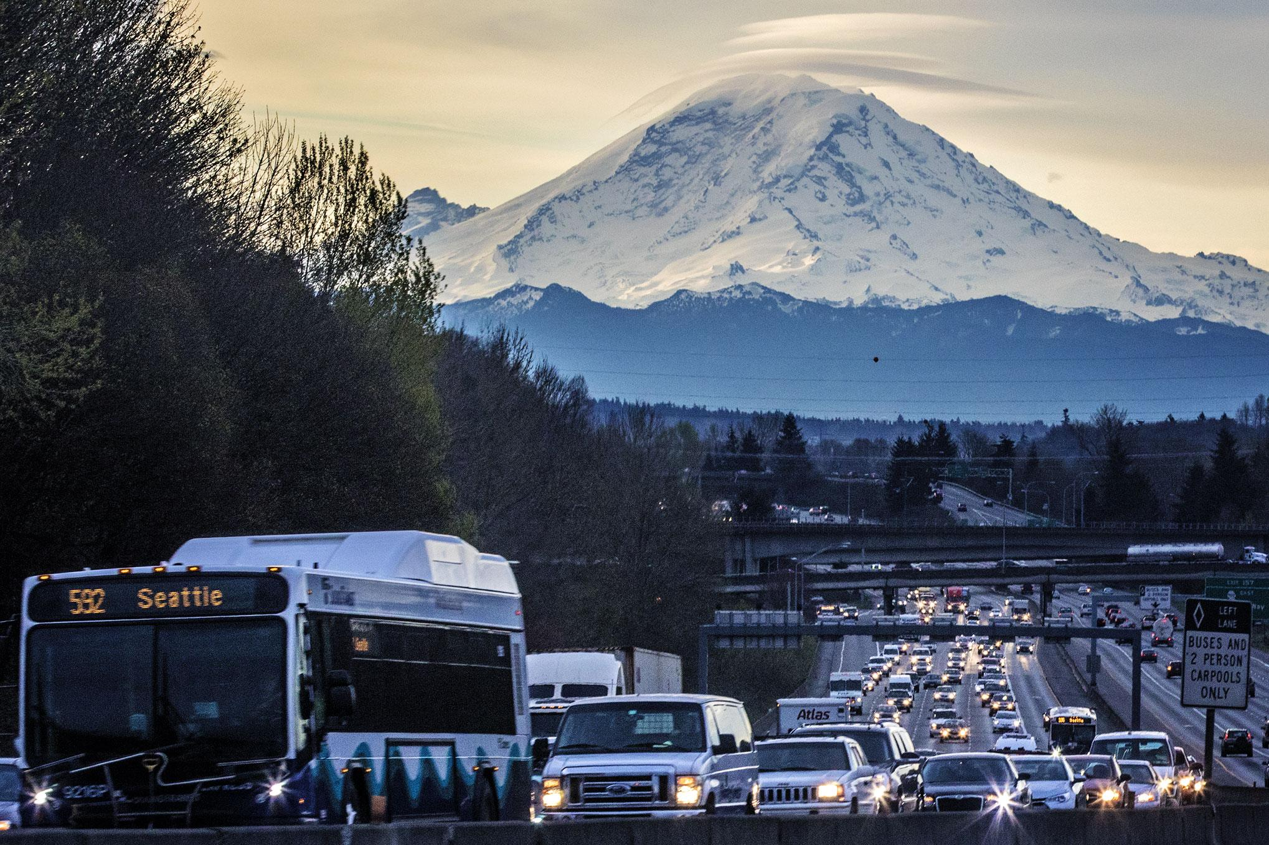
Best Model
For our data and problem, the best model is Support Vector Machine, predicting with a 74.44% of accuracy.
Government agencies can take action for this project to continue and someone make an app that uses this model to create an alert when conditions are met.

